Slide 1

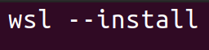
Bourne - again shell: Basics of navigating the command line
Windows users only: Please ensure you have installed Windows Subsystem for Linux (WSL):
Search for and open ‘Windows powershell’
When cursor is ready, type
When complete, must reboot laptop
Be patient after reboot - an Ubuntu terminal should pop up!
It will ask you to type a username (hit enter to proceed)
It will then ask you to set a password
Exit when complete
Note: open Windows File system
Click on ‘This PC’ on left hand side, open ‘C’ folder, open ‘Users’ folder and take note of your account folder’s name!

Slide 2
Session Objectives
To become familiar with common bioinformatics terminology
To be able to use bash commands to navigate in the terminal and manipulate files
To refresh or increase your command toolbox
To be able to make a simple bash script ?

Slide 3
Overview
Terminology
Why use bash?
Where is the terminal and how do I navigate within it?
Shuffling files (~30m)
Exploring files (~60m)
BREAK
Manipulating files

Slide 4
Caveats
I am not an expert!
There is nearly always multiple ways to achieve the same goal
Everyone googles!
There is always more to learn with a language :)

Slide 5
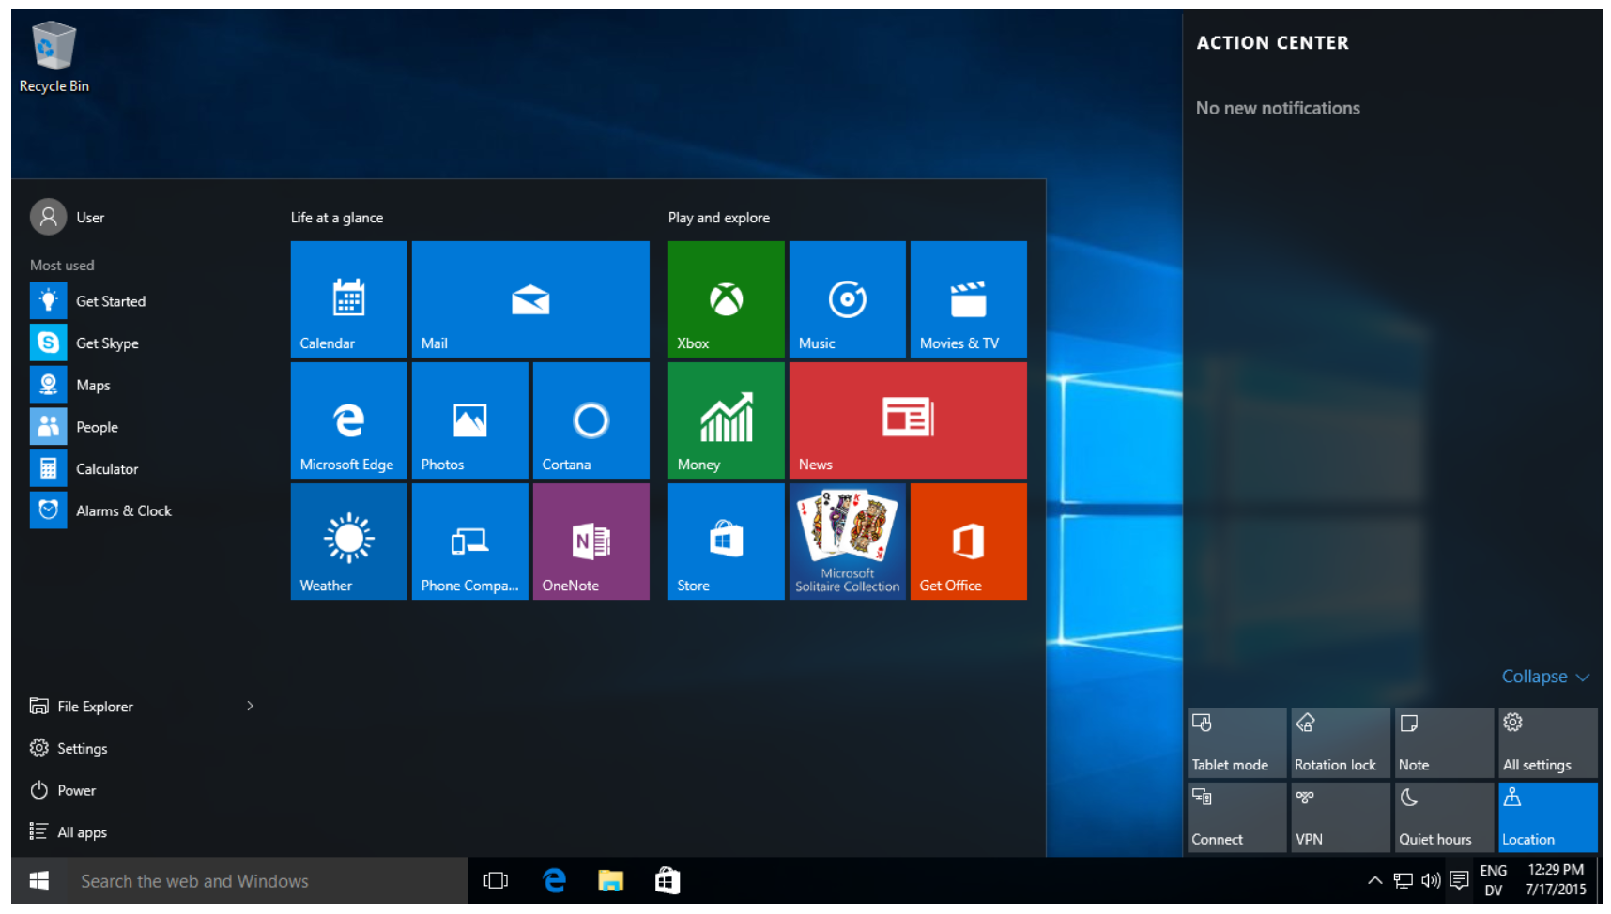
Some terminology!
Linux (Ubuntu is 1 ex.) and Windows are both operating systems (OS)
Free, open-source, customizable Not-free, user-friendly
A shell is a programme on the computer that provides a user interface to utilise the OS. It decides what to do with input, and what to output
(Windows/Mac/your phone has a “graphical” shell!)

Slide 6

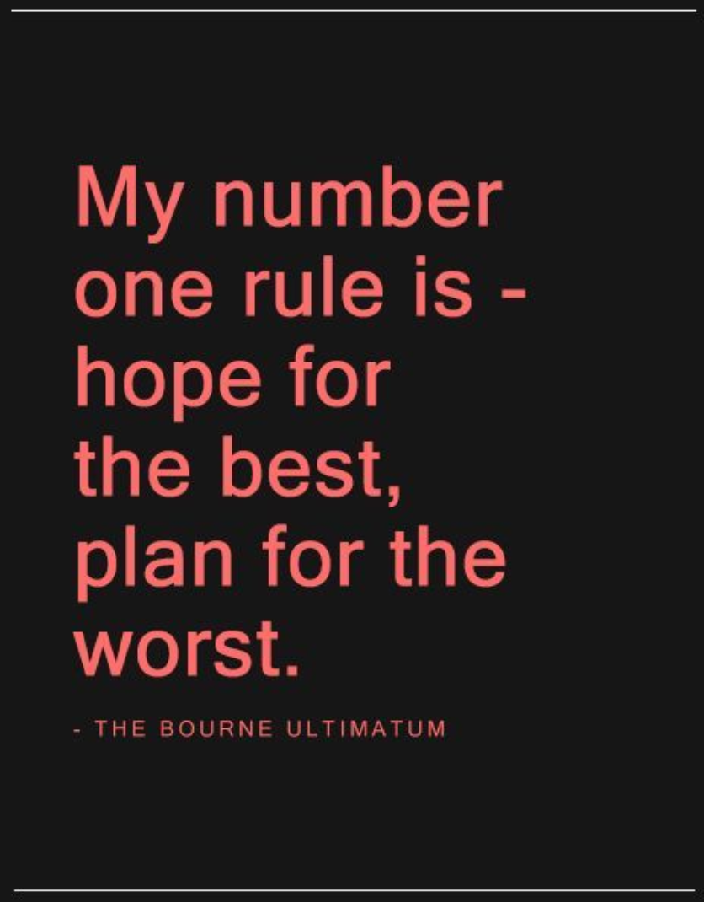
Some terminology!
Bash is the most popular shell for Linux-based OS
Bourne - again shell ! Free and enhanced version of the Bourne shell (1979)

Slide 7
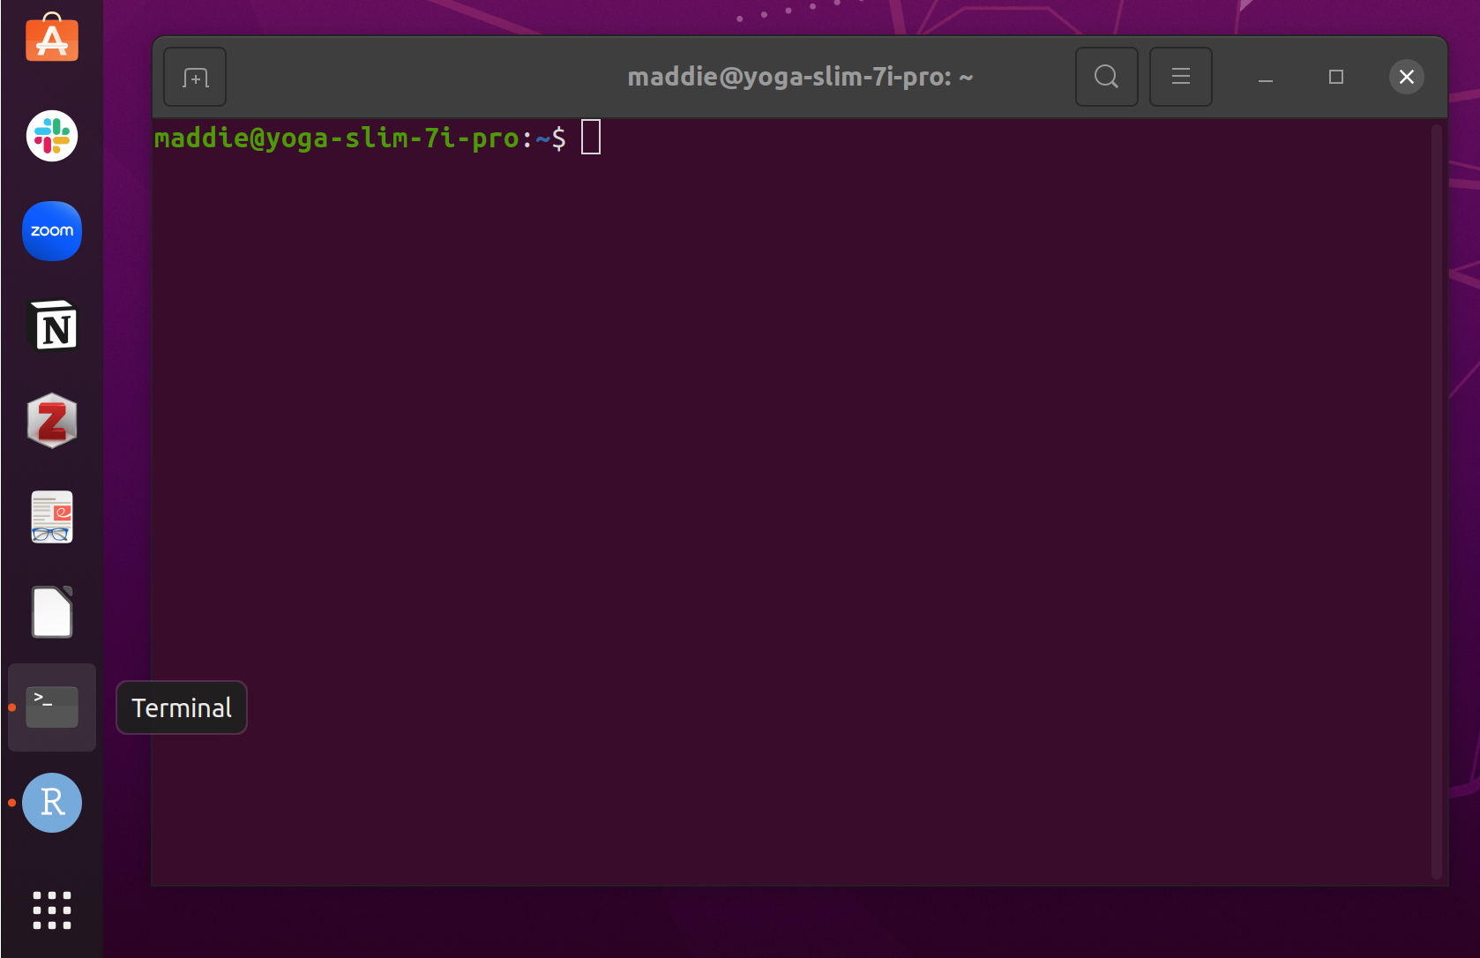
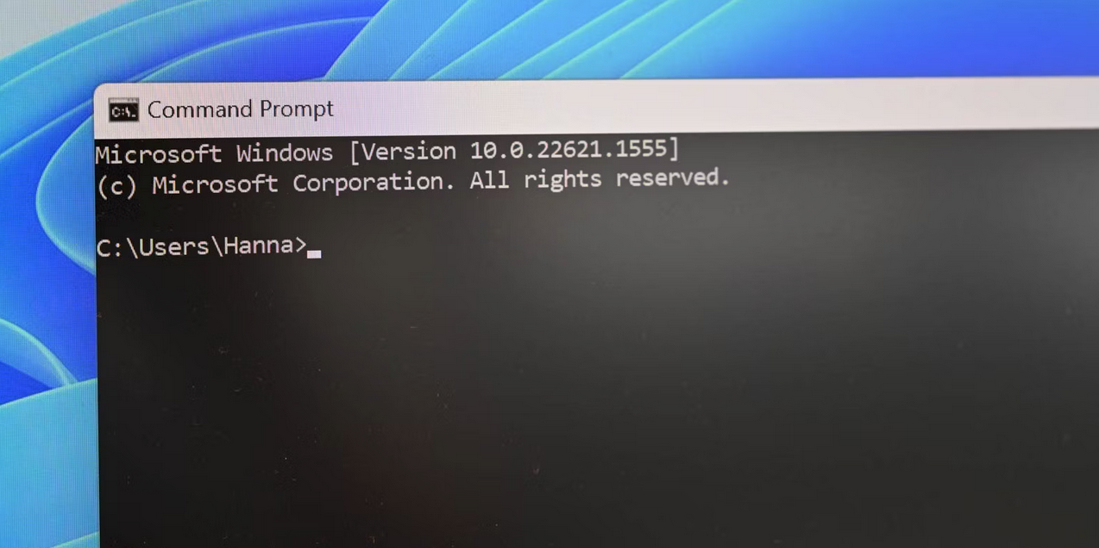
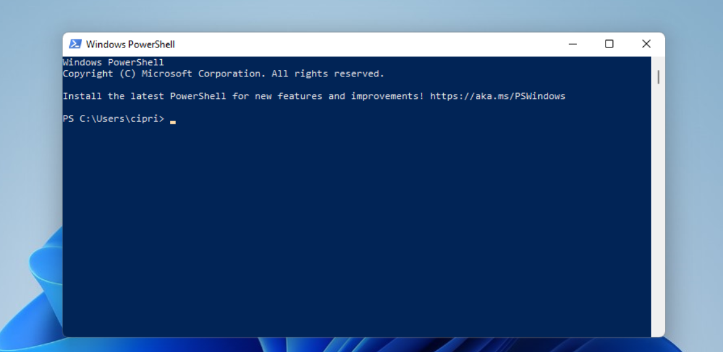
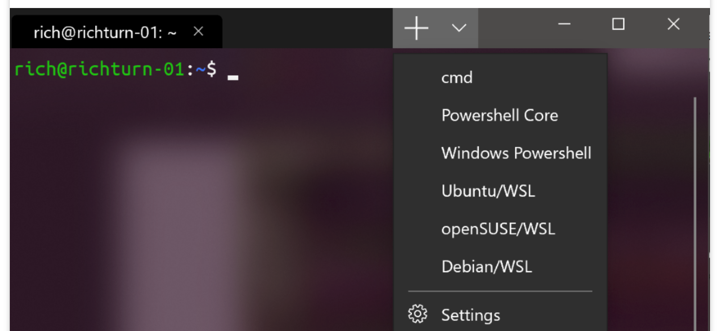
Some terminology!
The command line launches the default shell programme, enables user navigation and enables text input to/output from the shell
Each shell has their own language so some commands differ

Slide 8
Why use a shell and command language like bash?
Faster
More reliable (but!)
Efficient as can automate!

Slide 9
Now we know what we’re working with - how do I find the command line?
Search for ‘Terminal’ [Linux / Mac]
Type ctrl-alt-T [Linux]
Search for ‘Ubuntu’ [Windows - if already installed WSL correctly!]

Slide 10
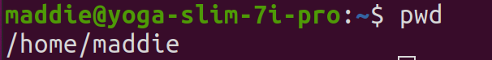
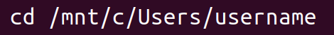
Navigating the command line
Directory = Folder
pwd = print working directory
Tells you where you are currently (working)!
Ie the path to, and name of, the folder you are in
cd = change directory
Can type a specific path to a file
Windows users! You need to navigate to your Windows files, so type
This is the location of all your files!
Notes:
20min?

Slide 11

Notes:
10min here

Slide 12
Navigating the command line (1/3)
Don’t always need the (full) path when using cd!
ls = list directories and files
cd dir_name OR cd ./dir_name = change directory to named directory
cd .. = go back to directory above
cd ../.. = go up two directories
cd - = go to previous directory
cd ~ = go to home directory

Slide 13
Shuffling your files (2/3)
Same syntax (path or not) for making, removing, moving and copying files!
mkdir = make a new directory
mkdir new_dir_name
touch = make a new empty file
touch newfile.txt
rm = delete a file - BE VERY AFRAID
rm newfile.txt
rm -r dir_name
rm -r * (magic character)

Slide 14
Shuffling your files (3/3)
Same syntax for making, removing, moving and copying files!
mv = move file
cp = copy file
Use two paths for these commands - a source and destination
mv newfile.txt ./../../folder_name/
cp /home/maddie/newfile.txt /home/maddie/another_folder/
mv /home/maddie/newfile.txt /home/maddie/another_folder/newname.txt
Notes:
Up to 30 min?

Slide 15
Exercise 1!
command --help OR man command (q to quit this one)
Github link: https://rb.gy/l5ee6e
- Download ‘bash_exercises.txt’ file
- Download ‘01data_seq-workshop_beyonce-lyrics.tsv’ file
How? Open bash directory, open the file and use three dots in top right to download
Try Exercise 1 :)
Notes:
Allow 10 mins to 40 mins

Slide 16
Follow-up tips!
command --help OR man command (q to quit)
Up arrow = history of used commands
Ctrl-c = cancel command and start on a new line
Tab = auto-fill

Slide 17

Notes:
Allow 10 mins to 50mins

Slide 18
Exploring your files (1/2)
less OR more = view what’s in your file, little at a time
wc = word count (-l -w -c)
head = print first 10 lines (head -n +10)
tail = print last 10 lines (tail -n -10)
head -n -2 = print file up to 2 from bottom (cuts last 2 lines)
tail -n +2 = print file from 2nd line (cuts only 1st line)
cat = print whole file!
| = pipe symbol
cat filename.txt | wc -l

Slide 19
Exploring your files (2/2)
We can start to edit them too!
vim filename.txt
Use arrow keys to navigate, dont type yet
Shift A to start editing/typing (shows INSERT at bottom)
PRESS ESC after editing (INSERT disappears) - MUST DO THIS to exit!
can always restart editing with Shift A
To exit saving changes type :wq! (will come up bottom left) and enter
To exit saving as new file :wq! newfilename.txt
To exit without saving changes :q!
Other shortcuts to exit saving changes type Shift ZZ (nothing will show on screen)
To exit without saving type Shift ZQ
nano filename.txt
Use arrow keys to navigate, can type as usual
Shortcuts labelled at the bottom:
^ is Ctrl
M is Alt
Ctrl X to exit, will ask if you want to save changes and rename or overwrite
Notes:
Up to 50 mins

Slide 20
Exploring your files (2/2) Exercise 2!
& BREAK
We can start to edit them too!
vim filename.txt
Use arrow keys to navigate, dont type yet
Shift A to start editing/typing (shows INSERT at bottom)
PRESS ESC after editing (INSERT disappears) - MUST DO THIS to exit!
can always restart editing with Shift A
To exit saving changes type :wq! (will come up bottom left) and enter
To exit saving as new file :wq! newfilename.txt
To exit without saving changes :q!
Other shortcuts to exit saving changes type Shift ZZ (nothing will show on screen)
To exit without saving type Shift ZQ
nano filename.txt
Use arrow keys to navigate, can type as usual
Shortcuts labelled at the bottom:
^ is Ctrl
M is Alt
Ctrl X to exit, will ask if you want to save changes and rename or overwrite
Notes:
Allow 10mins to 60 min? 10min BREAK to 70min

Slide 21

Notes:
2nd half. Allow 10 mins to 80min

Slide 22
More file manipulation! (1/2)
output > newfile.txt = write to a new file
output >> file.txt = append to the bottom of an existing file (or write to new)
Can also use these with strings and variables:
echo “sample ME134” > newfile.txt (echo = print)
myvar=“sample ME134”
echo $myvar >> file.txt ($ = read variable)
cat file1 file2 = concatenate (print one right under the other)
Paste file1 file2 = paste files alongside each other

Slide 23
More file manipulation! (2/2)
cut = select chunks from all lines
print 1st and 2nd character from each line
cut -c1,2 file.txt
print 3rd field of each line (or will print whole line)
cut -f3 file.txt
cut -d‘:’ -f3 file.txt
--complement = print everything except the selection
sort (-k? -n -r)
uniq (-c -d) = compares strings
note only works with adjacent lines!
Notes:
Up to 80min

Slide 24
More file manipulation! (2/2) Exercise 3
cut = select chunks from all lines
print 1st and 2nd character from each line
cut -c1,2 file.txt
print 3rd field of each line (or will print whole line)
cut -f3 file.txt
cut -d‘:’ -f3 file.txt
--complement = print everything except the selection
sort (-k? -n -r)
uniq (-c -d) = compares strings
note only works with adjacent lines!
Notes:
Allow 10 min to 90 mins

Slide 25

Notes:
Allow 10min to 100min

Slide 26
Last file manipulation - Introducing 2 powerful tools (1/3)
grep!
Search for lines with pattern(s)
grep “pattern” file.txt grep -e “pattern1” -e “pattern2” file.txt (-n -v -c -i -w)
Include lines before (B) and after (A) the line with pattern
grep -A2 “pattern” file.txt
Search for lines starting (^) or ending ($) with pattern
grep “^pattern” file.txt grep “pattern$” file.txt
Be careful with variables
grep “$variable” file.txt VS grep ‘$variable’ file.txt
MAGIC characters . (single character) and \ (exit character)

Slide 27
More file manipulation - Introducing 2 powerful tools (2/3)
Last but not least, sed! … with line numbers
Print a specific line number
sed -n 45p file.txt
Print a range of numbers
sed -n ‘1,15’p file.txt
Can use with variables
myvar=45
sed -n $myvar‘p’ file.txt
Delete a line
sed -i 45d file.txt (i = in-place, use with caution)

Slide 28
More file manipulation - Introducing 2 powerful tools (3/3)
sed! … for replacement
First instance only VS all instances (global) (I = ignore case)
sed ‘s/target/replacement/’ file.txt
sed ‘s/target/replacement/g’ file.txt
All instances in first 3 lines
sed ‘1,3 s/target/replacement/g’ file.txt
Can use with variables
myvar1=“target”
myvar2=“replacement”
sed ‘s/‘$myvar1’/‘$myvar2’/g’ file.txt (^/$ = starts/ends with)
Use sed -i to edit the actual file (in-place), exit magic character .
Notes:
Up to 100min.

Slide 29

Exercise 4
BREAK before 1pm
(Exercise 5 is something for you to take away and try another day!)
Notes:
Allow 20mins for last exercise and break before next session

